Slide 1



Strategic plan for Home on the Hill
August 18th, 2018

Slide 2
STRATEGIC PLAN FOR HOME ON THE HILL
Agenda
Client background and problem definition
Project Approach
Strategic recommendations
Key issues encountered and what’s next?

Slide 3
Client background and problem definition

Slide 4


CLIENT BACKGROUND AND PROBLEM DEFINITION
Home on the Hill | Background
Key numbers describing a small but effective organization with a wide reach
Home on the Hill (HOH) provides support to patients and families who experience severe mental illness
Established in 2011, HOH currently has seven Board members, small, passionate, enthusiastic, operates primarily in Richmond Hill and Vaughan
Vision and Mission: to provide a caring home environment that projects a sense of belonging, growth and security for all persons, by changing the way people are supported (gaps/flaws in current health system)
Current services include patient activity/therapy programs (art, music, cooking, yoga, vocational training), family/caregiver support/respite group, supportive housing (although currently only one tenant with part-time housing supported), and public education/outreach through the Robert Veltheer Lecture Series
Problems: lack of short-term and long-term strategy/vision (have had recent significant changes to Board), Board members are not aligned on strategic priorities/operations/expectations, concerns about financial sustainability/usage and impact of services

Slide 5

CLIENT BACKGROUND AND PROBLEM DEFINITION
Home on the Hill | Project objectives
A 3 step approach to help Home on the Hill
Gap Analysis
Current and future state assessment and gap analysis
Prioritization framework
To develop recommendations through the creation of a prioritization framework
Roadmap
To provide a realistic, agile and implementable strategic plan and roadmap

Slide 6
Project Approach

Slide 7

PROJECT APPROACH
Project approach |Overview
Overview of analysis done to come up with set of recommendations
Desk Review
Surveys
Data Analysis
Recommendations
Workshop Elicitation
Financial Analysis
Robert Veltheer Lecture
Competitive analysis
Participant Survey Set up
Board Member Interviews
Statistical Approach
Qualitative Approach
Data Conclusions
Strategic Priorities
Strategic Recommendations
High Level Action Plan
Financial analysis
Robert Veltheer lecture survey
Competitive analysis
Participants survey
Board interview
⤑ Performed financial analysis on financial statements going back to 2012
⤑ Focus groups held after attending Robert Veltheer lecture on ADHD as well as survey distributed to attendants
⤑ Analyzed and benchmarked non-profit organizations (regionally, Canada and internationally)
⤑ Distributed a survey to 700 people dealing with mental health, caregivers and mental health professions.
⤑ Received around 60 responses
⤑ Conducted individual board interviews with all the members of the board

Slide 8
PROJECT APPROACH
Project approach |Overview
Overview of analysis done to come up with set of recommendations
Analysis phase
Prioritization Framework
The set of potential recommendations were assessed via a prioritization framework:
Benefit – The potential benefit of implementing
Complexity – How likely Home on the Hill will be able to execute the strategy, keeping in mind the existing organizational capabilities
Optimal set of recommendations
Financial analysis
Increase the number of participants
Establish strategic partnerships
Leverage existing channels more
Introduce case management
Focus the service offering
Supportive housing services for longer term
Increase Robert Veltheer lectures frequency for shorter term
Pilot WRAP program – Wellness Recovery Action Plan
Robert Veltheer lecture survey
Board interview
Example:
Improve board efficiency
Define clear R&R within the board
Identify skills, define templates, organizational charter, document management system
Define and start measuring KPI’s
Participants survey
S1
4
Benefit
3
2
S2
Competitive analysis
1
1
2 3
4
5
Complexity

Slide 9
Strategic Recommendations

Slide 10
STRATEGIC RECOMMENDATIONS
Recommendations |High level recommendations
3 major categories of recommendations identified
Focus the service offering
Supportive housing services – plan for longer term
Increase Robert Veltheer lectures frequency – plan for shorter term
Pilot WRAP program – Wellness Recovery Action Plan
Increase the number of participants
Establish strategic partnerships
Leverage existing channels more
Introduce case management
Improve board efficiency
Define clear R&R within the board
Identify skills, define templates, organizational charter, document management system
Define and start measuring KPI’s

Slide 11
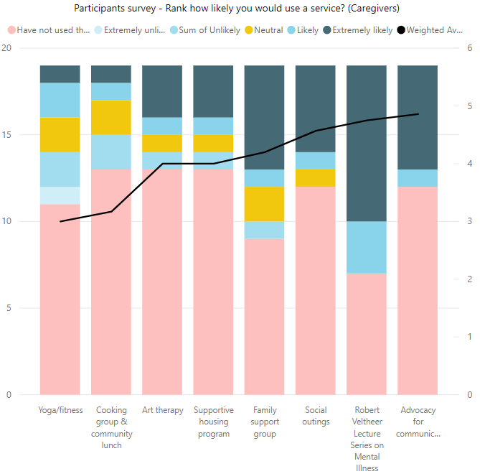
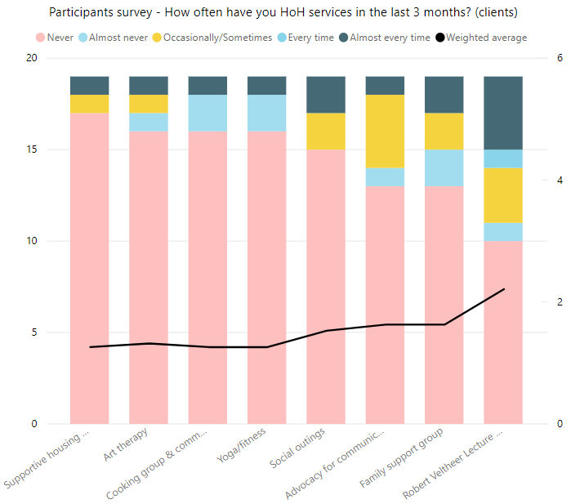
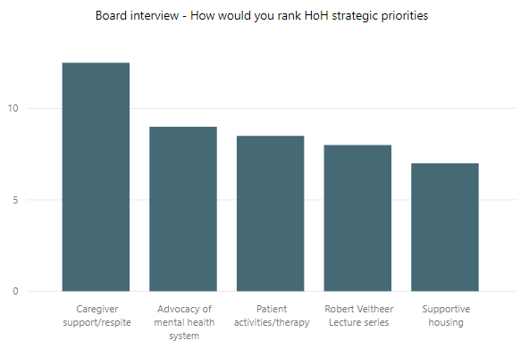
STRATEGIC RECOMMENDATIONS
Recommendations |Focus the service offering
Supportive housing services – plan for longer term
Competitive analysis of mental health organizations in the GTA showed that organizations offering supportive housing were very different compared to Home on the Hill
They all had annual revenues of > $4M
They often partnered with national organizations like Salvation Army to provide housing
Had additional services that complemented the supportive housing, such as intensive rehabilitation programs , on site care specialists and counselling options
Had strict criteria for those entering supportive housing and had a structured plan for their time spent.
In the surveys Supportive Housing was consistently ranked as relatively less likely to be used by caregivers compared to other programs. It was also currently the least used service of Home on the Hill.
When interviewed, Board members ranked supportive housing as the least important current strategic priority for HOH.
When asked about long-term and short-term vision of success for HOH, only two of six Board members mentioned supportive housing

Slide 12
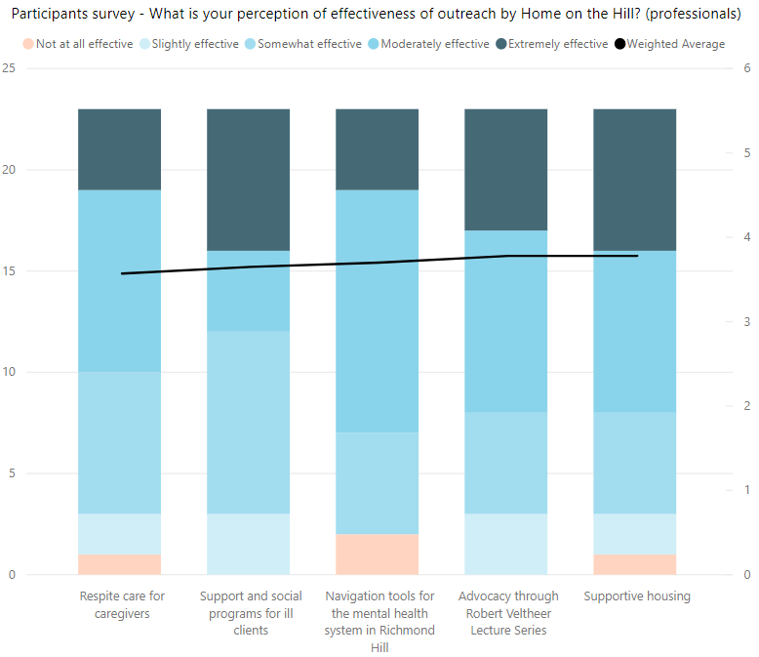
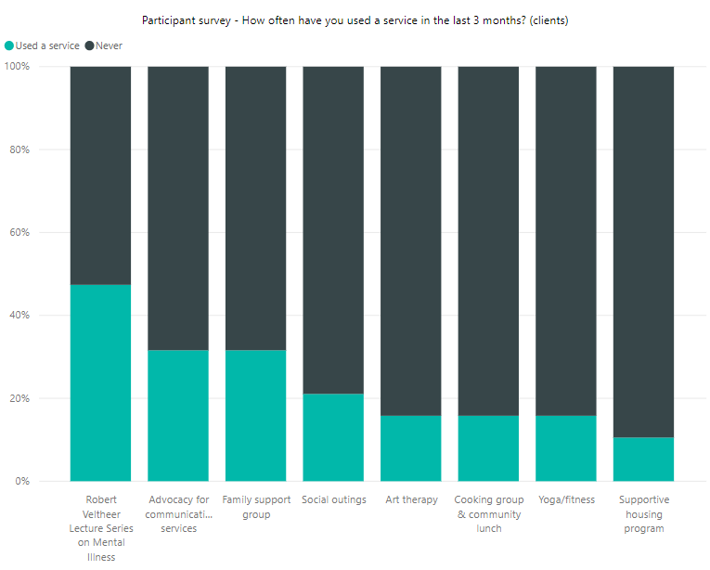
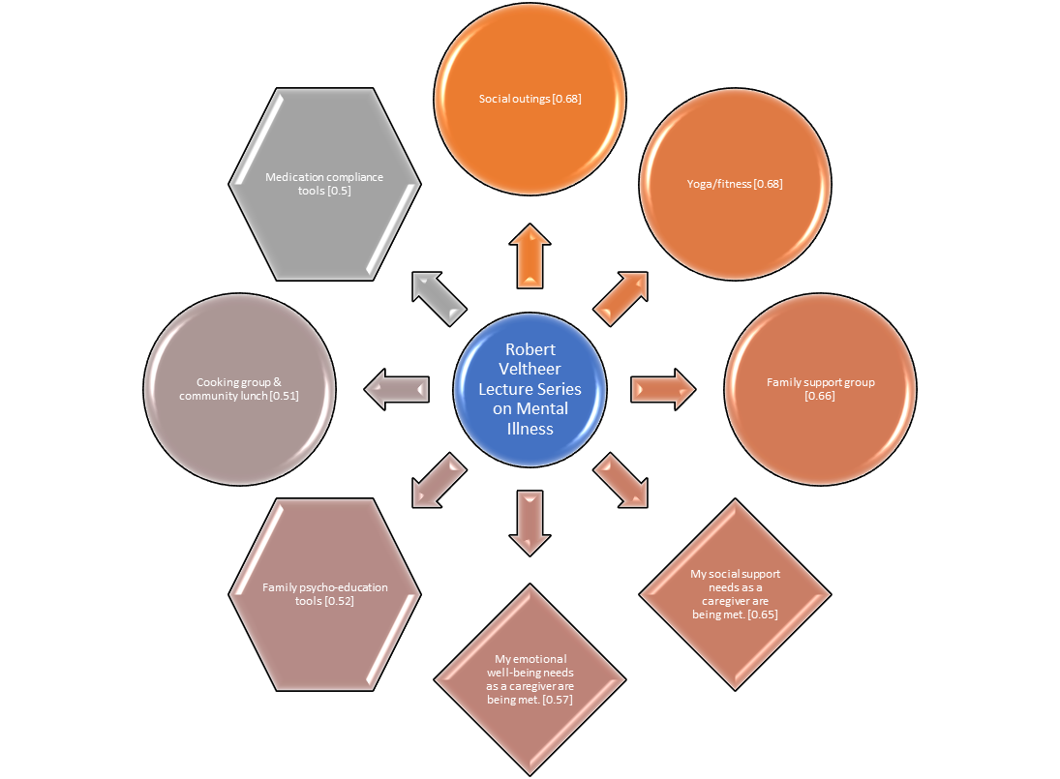
STRATEGIC RECOMMENDATIONS
Recommendations |Focus the service offering
Increase Robert Veltheer lectures frequency – plan for shorter term
Recommendation
The Robert Veltheer lecture series was mentioned consistently within the survey as a service which people were very likely to use, and people who attended the lectures were also much likelier to attend other Home on the Hill services (highly correlated).
Lecture series is important for HOH’s visibility in the community (as confirmed by Professionals who believe that Home on the Hill is best recognized for its lectures), which is acknowledged by Board members to support the long-term vision of success
When we compared the Robert Veltheer survey data to the participants survey, it was clear that the Veltheer lectures draw a wider audience than other Home on the Hill services. Therefore it is a great service to attract people not yet familiar with other Home on the Hill services and it should be used to market HOH’s service offerings.
The Veltheer lecture is unique within the community as it connect clients, caregivers and professionals and allows for interaction between them. We would consider increasing the frequency of the lectures (at least 1 per quarter) or consider setting-up “meet the professional” sessions where clients and caregivers can have a informal Q&A session with professionals.

Slide 13
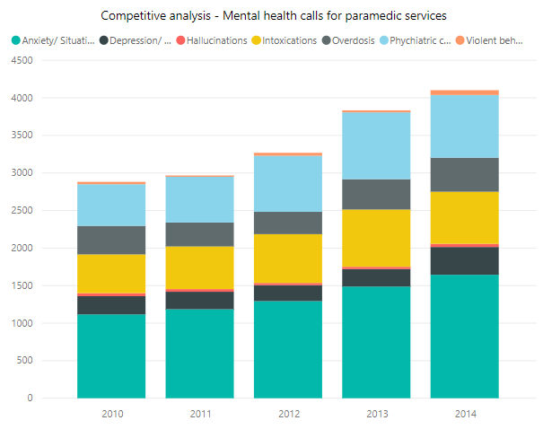
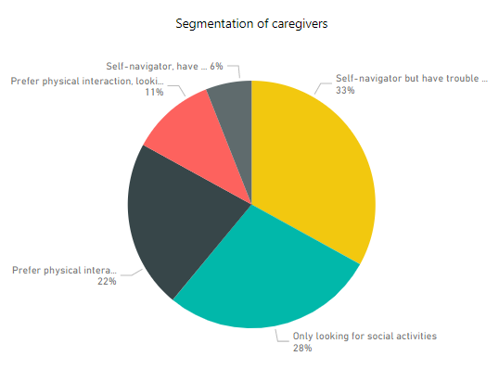
STRATEGIC RECOMMENDATIONS
Recommendations |Focus the service offering
Pilot WRAP program – Wellness Recovery Action Plan
Recommendation
WRAP (Wellness Recovery Action Plan) is a prevention and wellness program that anyone can use to get well and stay well. It is often offered in group settings, where participants meet weekly for 8-10 weeks.
WRAP has been studied extensively in rigorous research projects and is listed in the National Registry of Evidence-based Programs and Practices. It is used extensively in many of the leading mental health centres in the GTA

Slide 14
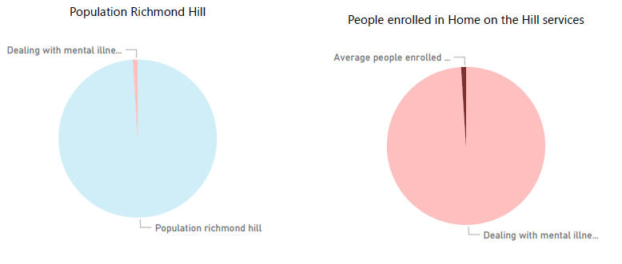
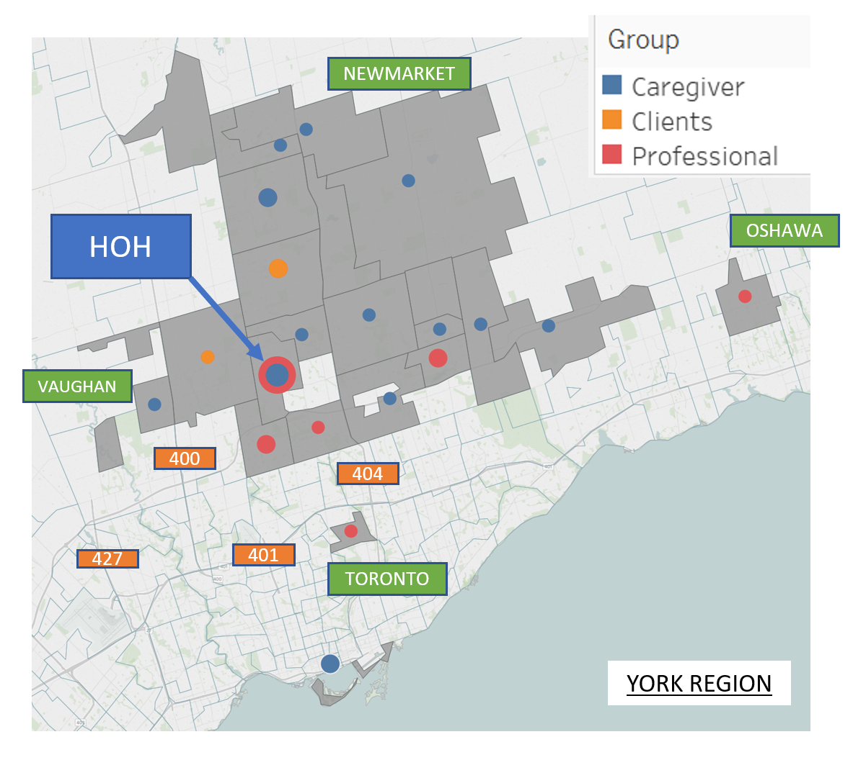
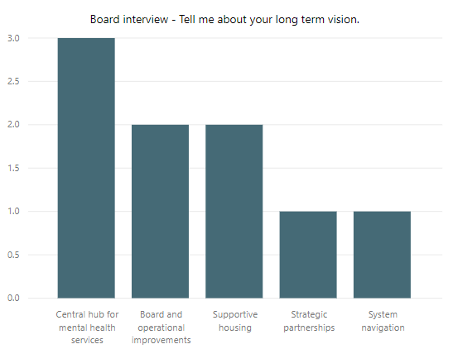
STRATEGIC RECOMMENDATIONS
Recommendations |Increase the number of participants
Establish strategic partnerships (1/2)
When looking at the where Home on the Hill clients' come from, and comparing that to the amount of people dealing with mental illness in the Richmond Hill area (2000) there is still a large amount of people that Home on the Hill could reach (Home on the Hill only captures 1% of the Richmond Hill market).
According to professionals Home on the Hill is less known for the effectiveness of their core services (Support programs and respite care for caregivers). Strategic partnerships with respected organizations will be instrumental in changing that perception and will help with getting referrals from hospitals.
Competitive analysis learned that almost all of mental illness organizations partner-up in order to offer complementary services, share marketing and outreach channels and share expertise. Home on the Hill on the contrary has no strategic partnership.
The most shared long-term vision of the board was to act as a central hub for mental health services. Strategic partnerships will be instrumental in achieving that vision.

Slide 15
STRATEGIC RECOMMENDATIONS
Recommendations |Increase the number of participants
Establish strategic partnerships (2/2)
Group Type | Potential Partner
 | Name | Why
Health Centers | Krasman Centre | To offer joint unique programs, to share space, to advertise events to local community, Caregiver Programs could be enhanced by teaming up with Krasman Centre
 | Ontario Shores Centre for Mental Health Sceinces | Ontario Shores specializes in Mental Health Sciences, a better opportunity to address common mental health needs. Also a mental health Education resource.
 | Southlake Regional Centre | Aurora (additional chapters in surrounding communities)
 | LOFT/Crosslinks Housing and Support Services | LOFT offers a range of services to a wide audience. Robert Veltheer lecture series could be advertised. Case Management and Community Integration services could be leveraged
Health Professionals and Services | Mackenzie Health | Partnership with a local hospital would generate referrals to programs in demand. Would enable local visibility
 | Markham - Stouffville | Partnership good for long term growth and education of the local community.
Organizations (Local and Regional) | Canadian Mental Health Association CMHA | Programs offered are. MOBYSS – Mobile Walk in Clinic, Case Management Services. Partnerships could be formed for Family and Caregiver Group. For training Mental Health First Aid Basic (2-days) is offered by CMHA
 | Alzheimer Society of York Region | Partnerships for family caregiver programs or lecture series.
 | Belinda's Place | Belinda’s Place is women only organization, focused on transitional programs, case management, housing outreach.
 | Blue Door Shelters | Wide range of services offered and a large partner network
 | Elizz - All Things Caregiving | Strong expertise in Caregiving.
Online Resources | Online Support through Big White Wall https://www.ontarioshores.ca/ | A round-the-clock online peer support community where members can share experiences and express themselves in words and images, helping participants feel less socially isolated
 | CareGiver Exchange | An online platform for caregivers..

Slide 16
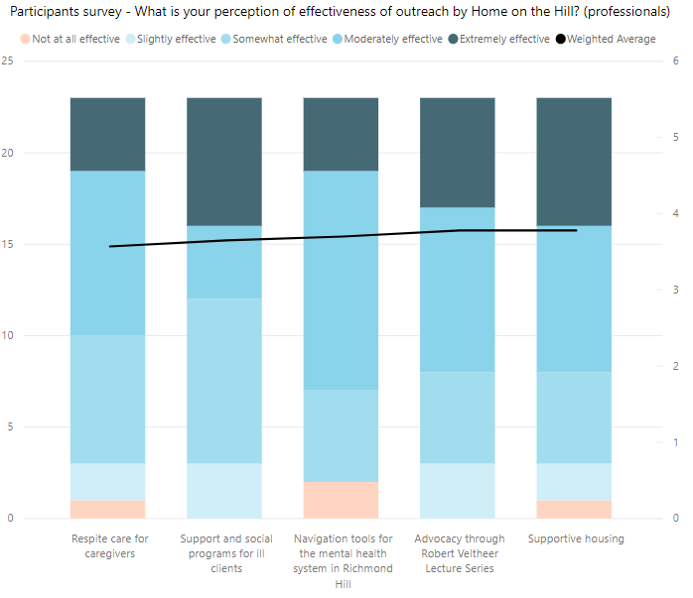
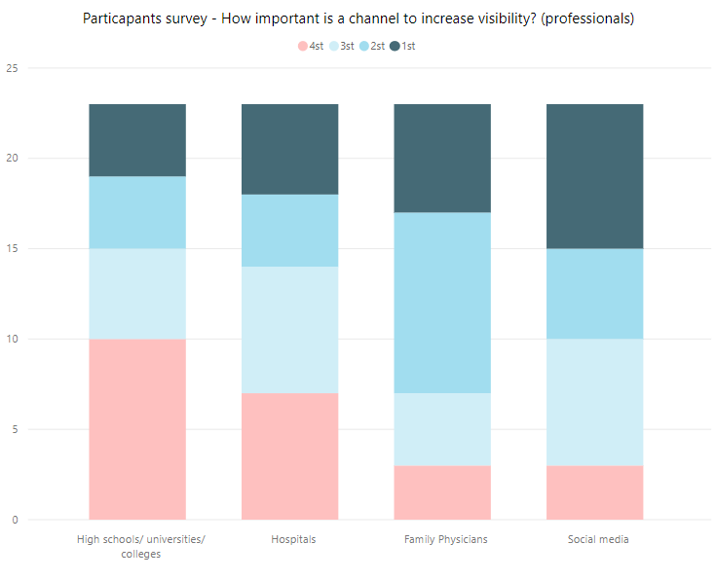
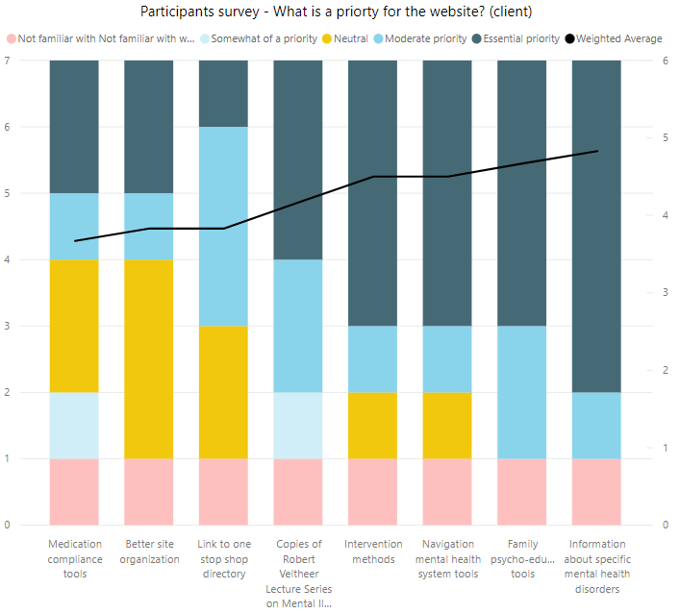
STRATEGIC RECOMMENDATIONS
Recommendations |Increase the number of participants
Leverage existing channels more
Recommendation
Home on the hill already has a well established presence on social media (twitter, facebook which they mainly use this for “social and community outreach”. Home on the Hill mainly used their social media to share articles about mental illness and developments in the community.
We believe Home on the Hill should leverage this channel better to promote Home on the Hill services and in particular their respite care and support programs since they, in the opinion of professionals, have the worst perception of effectiveness.
According to professionals, social media is the best way to increase Home on the Hills visibility.
From the conducted participants survey, we identified key website resources that would attract new participants looking for information on specific mental illnesses, family psycho-education tools and tools to navigate the mental health system. This would attract more people to attend the Home on the Hill services and will go along with the long term vision Home on the Hill being a community hub.

Slide 17
STRATEGIC RECOMMENDATIONS
Recommendations |Increase the number of participants
Introduce case management
Recommendation
We see an opportunity to start case management in order to activate clients and caregivers who know Home on the Hill. There is a reasonable discrepancy between clients attending programs because they want to learn skills and become more independent, or clients who want to make more friends and share knowledge.
We identified key segments (through segmentation analysis) and believe case management would offer different approaches and programs to support those clients and caregivers. Case management would help navigate the support services offered by Home on the Hill.
Finally, case management would be key in the creation of a central hub for mental health services, helping people navigate the system and follow them when their priorities and needs change.

Slide 18
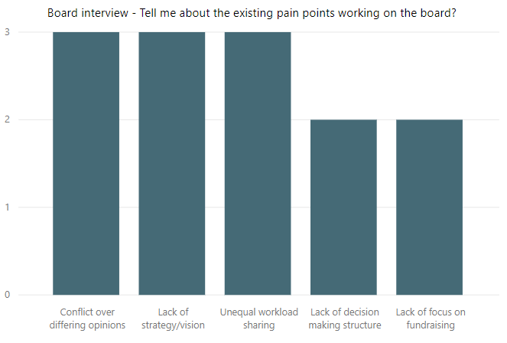
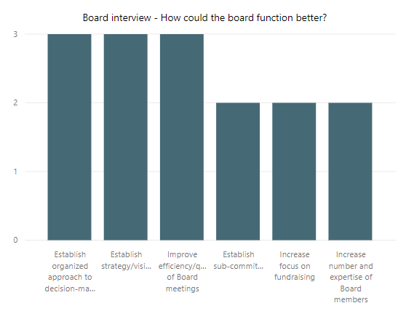
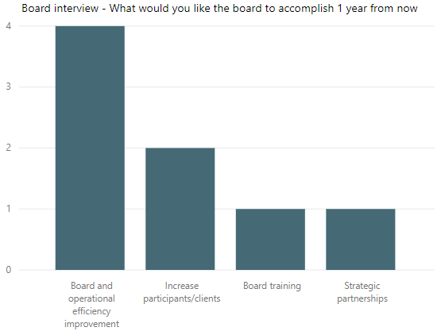
STRATEGIC RECOMMENDATIONS
Recommendations |Improve board efficiency
Define clear roles, responsibilities and decision-making structure within the board
It is very clear that Home on the Hill’s board is not functioning efficiently. Those board inefficiencies were recognized by all the board members as the number 1 short-term priority.
The definition of clear roles and responsibilities, as well as a decision making approach will unlock a lot of the potential Home on the Hill has as organization.
Another way for Home on the Hill to increase efficiency would be to establish “committees”. Right now ad-hoc board actions (fundraising, outreach, daily activities) leave no room for strategic planning. Specialized committees would alleviate some of these pressures and would allow more time for strategic planning and decision-making.
Two of the most common pain points Board members are experiencing is with respect to conflict as a result of differing opinions and unequal sharing/expectations of work effort. Committees would also allow different members of the board to be able to contribute and address the unequal workload sharing.

Slide 19
STRATEGIC RECOMMENDATIONS
Recommendations |Improve board efficiency
Identify skills, templates, organizational charter, document management system
Recommendation
The most common response from Board members for what should be accomplished in the next year was to improve the efficiency of the Board and operations
Establishment of clear roles and responsibilities, improvement of decision making structure and overall improvement of organization/efficiency habits of the Board could be improved by:
1) Identifying/documenting skills of each Board member
2) Documenting an organization chart
3) Establishing a document management system for each Board member to have easy access/retrieval of documents and meeting minutes

Slide 20
STRATEGIC RECOMMENDATIONS
Recommendations |Improve board efficiency
Define and start measuring KPI’s
Recommendation
Some pain points Board members are experiencing is with respect to lack of structure in decision-making and Conflict as a result of differing opinions.
One key area identified by Board members to help alleviate these pain points is to establish an organized approach to decision-making. KPI’s (Key Performance Indicators) can be used to measure success and define criteria for making decisions.
Data collection would allow Home on the Hill to track attendees throughout their various support services and would help optimization of their service portfolio, the identification of gaps and effectiveness of new strategies.
Lastly, a common theme in grant or funding applications is to show the effectiveness of your service offering. The collection and set-up of data collection will streamline the grant writing process and shows the credibility of the organization.

Slide 21
What’s next?

Slide 22
WHAT’S NEXT?
Key issues encountered
Board
Data
Financials
Gaining alignment for the mission and vision from Board members
Frequent turnover of the Board members
Board members functioning as a working Board
Dysfunctionality within the current board
No KPI’s or detailed operational information
Hard time getting key parts of HoH to fill out the survey (clients)
Between February and May 2018, HOH reduced support programs from running 29 in February to 16 per month in May
HOH spend a lot of effort in trying to apply for central LHIN funding which would quintuple their yearly working budget which would have changed the proposed strategy drastically.
Home on the Hill only has a working budget of around 20,000 a year.

Slide 23

WHAT’S NEXT?
What’s next?
Analysis phase
Recommendation phase
Roadmap phase
Flesh out the WRAP (Wellness Recovery Action Plan) program
Define a high level roadmap
Board interview
Finished
Participants survey
Collect more survey results
Define optimal social media and website strategy
Competitive analysis
Dig deeper into the competitive analysis part
Go through board templates and prospective charter for processes w/ board
Final client deliverable/ presentation

Slide 24
Questions?

Slide 25
Appendix

Slide 26
STRATEGIC RECOMMENDATIONS
Recommendations | Potential Partners – York Region Community Partners
HOH should investigate the potential of partnering with a wide variety of community groups
York Region Community Organizations By Type | Commentary
 | Over 100 community organizations are active in York Region that express a potential desire for partnership with HOH While the focus of these groups varies, they may have complementary activities that can be leveraged by both organizations.
 | Example Organizations
2
Type | Examples
Mental Health | Schizophrenia Society of Canada, Krasman Centre, Catholic Community Services of York Region
Health Services | All-Care, Health & Staffing Services, Health Care Services, Richmond Health Centre
Community Health Centers | Ontario Shores, Southlake Regional Health Centre, Blue Hills Child and Family Services LOFT Cross Links
(1) Source: CIVICYork – Community Information and Volunteer York Region,; website:https://york.cioc.ca/ . (2) Includes organizations and regional overarching organizations
Notes:
26

Slide 27














STRATEGIC RECOMMENDATIONS
Recommendations | Potential Partners – York Region Community Partners
HOH should investigate the potential of partnering with a wide variety of community groups
Partnership Rationale | Group Types | Approach
Group is well-connected in the community, has an interest in serving community's best interest Group is involved in community activities and can be partnered with to promote the HOH message | Health Centers | Ask for introductions in connecting with others in the community who may be able to assist in furthering the message or in reaching those in need to services
Word of mouth is one the most efficient ways to increase referral rates | Health Professional Health Services | Visible presence in group locations (flyers, posters, etc) Ask for referrals, where appropriate, of Clients in need of HOH services
Group is providing complementary services and putting HOH on the map for a particular region | Mental Health (regional organizations) Mental Health (local organizations) | Ask for inclusion in regional services database such as Central LHIN, CMHA York Region etc. Ask for educational resources for HOH catchment area
Notes:
27

Slide 28
STRATEGIC RECOMMENDATIONS
Recommendations | Potential Partners – York Region Community Partners
HOTH should investigate the potential of partnering with a wide variety of community groups
Group Type | Potential Partner
 | Name | Why
Health Centers | Krasman Centre | To offer joint unique programs, to share space, to advertise events to local community, Caregiver Programs could be enhanced by teaming up with Krasman Centre
 | Ontario Shores Centre for Mental Health Sceinces | Ontario Shores specializes in Mental Health Sciences, a better opportunity to address common mental health needs. Also a mental health Education resource.
 | Southlake Regional Centre | Aurora (additional chapters in surrounding communities)
 | LOFT/Crosslinks Housing and Support Services | LOFT offers a range of services to a wide audience. Robert Veltheer lecture series could be advertised. Case Management and Community Integration services could be leveraged
Health Professionals and Services | Mackenzie Health | Partnership with a local hospital would generate referrals to programs in demand. Would enable local visibility
 | Markham - Stouffville | Partnership good for long term growth and education of the local community.
Organizations (Local and Regional) | Canadian Mental Health Association CMHA | Programs offered are. MOBYSS – Mobile Walk in Clinic, Case Management Services. Partnerships could be formed for Family and Caregiver Group. For training Mental Health First Aid Basic (2-days) is offered by CMHA
 | Alzheimer Society of York Region | Partnerships for family caregiver programs or lecture series.
 | Belinda's Place | Belinda’s Place is women only organization, focused on transitional programs, case management, housing outreach.
 | Blue Door Shelters | Wide range of services offered and a large partner network
 | Elizz - All Things Caregiving | Strong expertise in Caregiving.
Online Resources | Online Support through Big White Wall https://www.ontarioshores.ca/ | A round-the-clock online peer support community where members can share experiences and express themselves in words and images, helping participants feel less socially isolated
 | CareGiver Exchange | An online platform for caregivers.
Notes:
28

Slide 29
STRATEGIC RECOMMENDATIONS
Recommendations | Corporate Partners
York Region Employers By Sector¹ Segmented by # of employees; as of 2016 | Commentary
 | There are over 30,000 employers in the York Region, encompassing a wide array of industry sectors Roughly 2/3^{rds} of the firms have fewer than 50 employees
 | Major Employers
5,292
3,755
3,325
3,126
2,895
2,647
2,580
1,782
1,366
1,270
975
806
608
526
Sector | Examples
Health care and social assistance | Canadian Health Mental Association, United Way, Region of York, Ontario Ministry of Health Promotion and Sport, Salvation Army, Ontario Trillium Foundation
Educational Services | York Region Board of Education, Seneca, Community Education Centre-Central, York Region District School
Accommodation and Food Services | McDonalds, The Keg, Hilton, Sheraton
356
206
194
30
20
10
# of employees
(1) Source: 2016 York Region Business Directory, website: http://www.yorklink.ca/york-region-interactive-business-information/; excludes 1,424 employers with no NAICS code or # of employees
Notes:
29

Slide 30
STRATEGIC RECOMMENDATIONS
Recommendations | Corporate Partners
Recommend focusing on three types of employers – in the Retail Trade, Manufacturing, and Accommodation and Food Services sectors
Segment | Rationale | Messaging
Health Care and Social Assistance | Strong population of medium-to-large firms, meaning greater scalability of potential partnerships Large number of smaller firms to partner with should provide a more targeted approach be utilized | Message: promotion of flagship program and advocacy for mental health. Seek collaboration on unique program offerings.
Educational Services | Moderate population of medium-to-large firms, meaning some potential to scale partnership referrals with one point of contact | Message: ensure firm is aware of mental health awareness services offered; partner with subject matter experts from health related fields
Accommodation and Food Services | Strong population of medium-to-large firms, meaning greater scalability of potential partnerships Could be used for catering for events such as Robert Veltheer Series | Message: seek collaboration on programs related to health and wellness. Promotion through flagship programs
Segment | Potential Partner
 | Name
Health Care and Social Assistance | Canadian Health Mental Association , United Way, Region of York, Ontario Ministry of Health Promotion and Sport, Salvation Army, Ontario Trillium Foundation, Hockey helps the homeless,
Educational Services | York Region Board of Education, Seneca, Community Education Centre-Central, York Region District School
Accommodation and Food Services | McDonalds , Tim Horton’s, Cora’s Breakfast and Lunch, Local Deli’s and Bakery
Notes:
30

Slide 31
STRATEGIC RECOMMENDATIONS
Recommendations | Partners Implementation Plan
Create meaningful partnerships within the region to create more referrals and mental health awareness
Segment | Near term Within 90 days | Mid-term 3 -9 months | Long-term 9 months +
Partnerships | Develop partner assessment framework to rank partnership opportunities Identify potential partners leveraging York Region business directory in the region Assess resources required and what will be required. | Prepare a final partner package that outlines -what can the partner expect from HOH Approach potential partners a partnership with local companies/social agencies to build awareness and engagement in your organization | Assess value of partnership on a regular basis, considering resourcing required to support vs referrals Where appropriate, look to deepen partnerships, such as through representation on the board.
Notes:
31

Slide 32
STRATEGIC RECOMMENDATIONS
Competitive Analysis
Notes:
32

